Slide 1

Crime Management System
Object-Oriented Programming Project
Developed in C++
Uses OOP Concepts and File Handling
Proposed By: Abiha Musaddaq & Hamd Amjad
Enrollments: 08 & 26
BSCS-2A
Instructor: Ms.Zoobia Fatima

Slide 2

Project Overview
A console-based C++ application used to manage crime records digitally.
Objectives
Store crime records efficiently
Reduce manual paperwork
Allow searching, updating, and deleting records
Demonstrate real-world use of OOP concepts

Slide 3
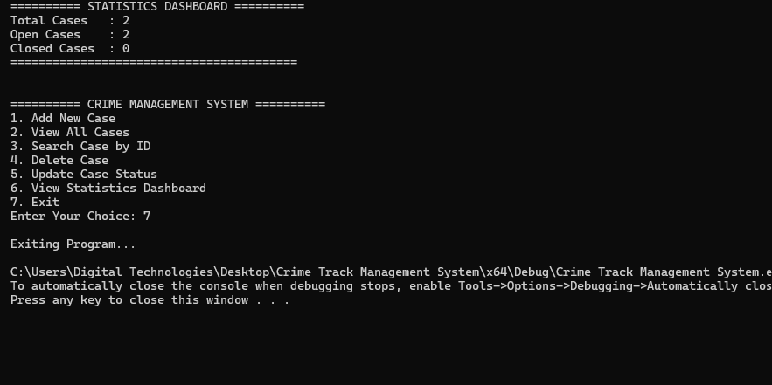
Main Features
Add new crime records
View all records
Search by Case ID
Update case information
Delete records
Show statistics (Open/Closed cases)

Slide 4
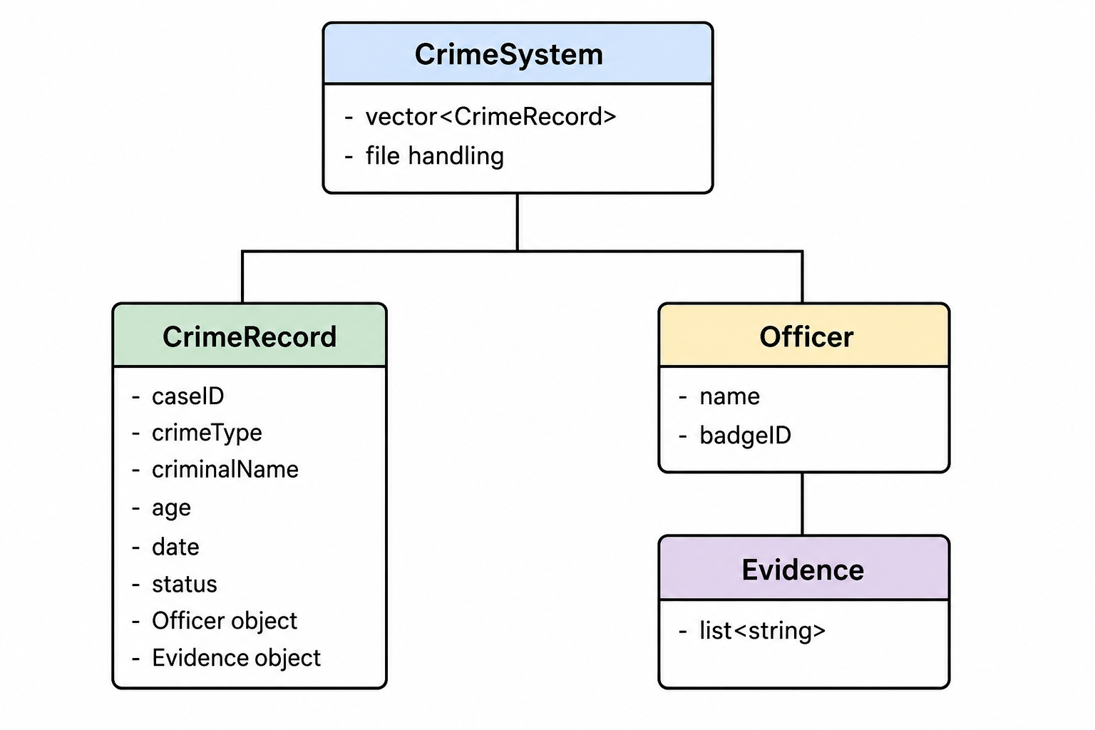
System Design (Classes Used)
Classes
CrimeRecord – Stores case information
Officer – Stores officer details
Evidence – Stores evidence information
CrimeSystem – Manages all operations
Relationship
CrimeSystem manages CrimeRecord
CrimeRecord contains Officer and Evidence

Slide 5
OOP Concepts Used
Encapsulation – Private data members
Abstraction – Menu-driven interface hides complexity
Composition – CrimeRecord includes Officer and Evidence
Polymorphism – Virtual functions for displaying data
File Handling – Saves records permanently in files

Slide 6
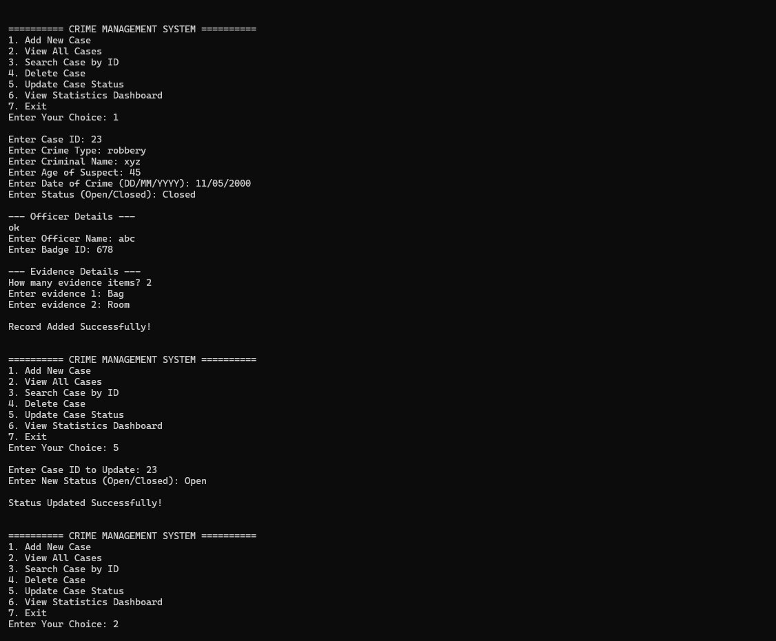
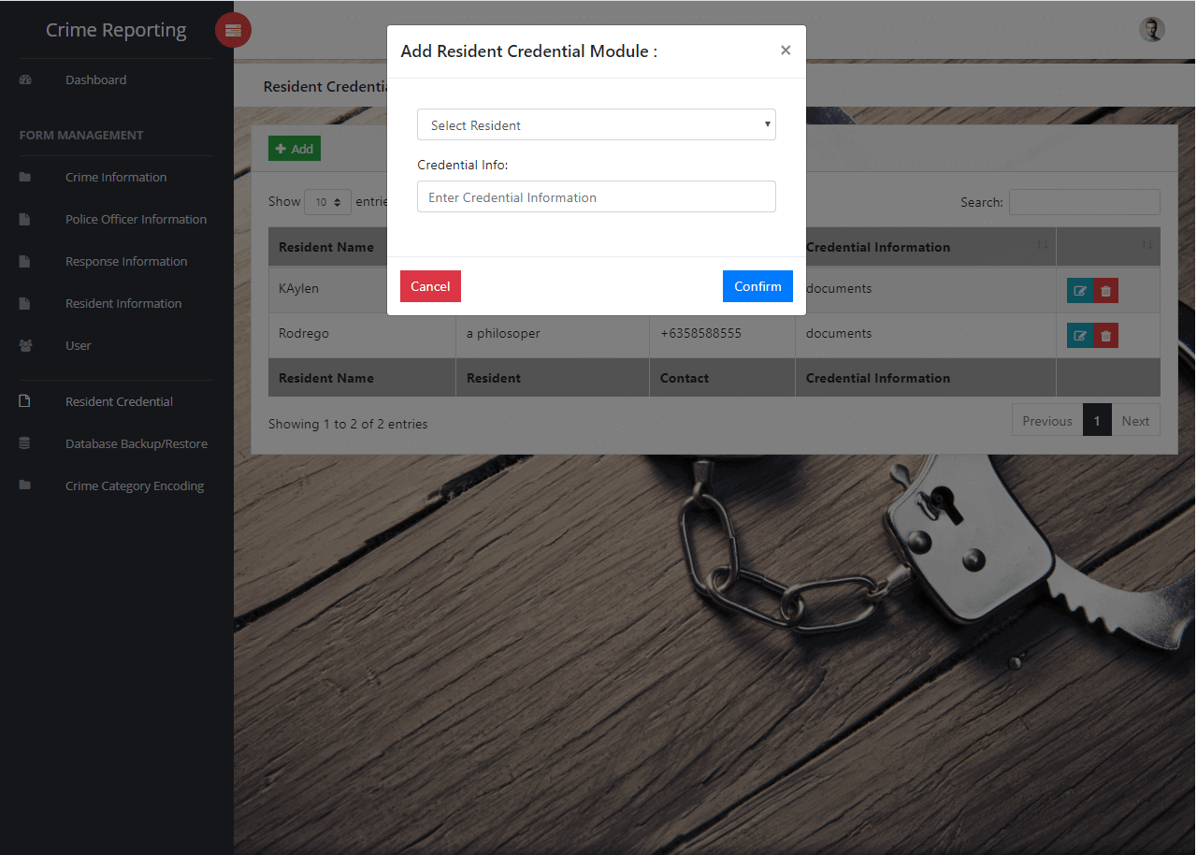
Workflow & Future Enhancements
Workflow
User selects an option from the menu
System processes the request
Data is saved or updated in file
Output is displayed
Future Enhancements
Login system
GUI using SFML or Qt
Database integration
Advanced filtering and reports

Slide 7
Conclusion
Successfully implemented a crime record management system
Demonstrated practical use of OOP concepts
Easy to extend and improve

Slide 8
Thank You !

